Slide 1
Week 5 Heuristic Search Strategies Beam Search & A*Search

Slide 2
Beam Search
Greedy Algorithm
Beam search is an optimization of best-first search.
In Beam Search Only the most promising nodes at each step of the search are considered for further branching?
Beam Search was developed in an attempt to achieve the optimal (or sub-optimal) solution without consuming too much memory, How?
What was Best First Search?
Best First Search was Good Enough?
What was the Drawback?

Slide 3
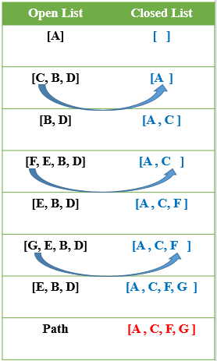
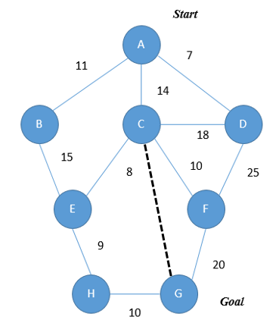
Best First Search?
Node | H(n)
A→G | 40
B→G | 32
C→G | 25
D→G | 35
E→G | 19
F→G | 17
G→G | 0
H→G | 10

Slide 4

Beam Search
Greedy Algorithm
Beam search is an optimization of best-first search that reduces its memory requirements.
Only the most promising nodes (instead of all nodes) at each step of the search are retained for further branching.
Beam Search was developed in an attempt to achieve the optimal (or sub-optimal) solution without consuming too much memory.
Explore a Graph by expanding the most promising node in a limited set.
What is Limited Set?
Beam Value is also called Beta or Beam Width refers to the number of nodes to be expand. ( Value is Given)

Slide 5
Beam Search Algorithm
OPEN = {initial state}
while OPEN is not empty do
1. Remove the best node from OPEN, call it n.
2. If n is the goal state, return path.
3. Create n's successors.
4. Evaluate each successor, add it to OPEN, and record its parent.
5. If |OPEN| > ß , take the best ß nodes (according to heuristic) and remove the others from the OPEN.
Done

Slide 6
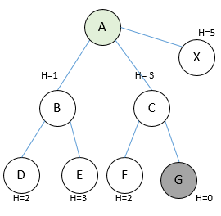
Completeness of Beam Search
In general, the Beam Search Algorithm is not complete.
Even given unlimited time and memory, it is possible for the Algorithm to miss the goal node
A more accurate heuristic function and a larger beam width can improve Beam Search's chances of finding the goal.
Clearly, open set becomes empty without finding goal node .
Steps
OPEN= {A}
OPEN= {B,C}
OPEN={D,E}
OPEN={E}
OPEN={}

Slide 7
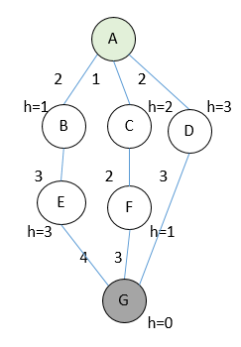
Optimality In Beam Search
Just as the Algorithm is not complete, it is also not guaranteed to be optimal.
This can happen because the beam width and an inaccurate heuristic function may cause the algorithm to miss expanding the shortest path.
A more precise heuristic function and a larger beam width can make Beam Search more likely to find the optimal path to the goal.
1. OPEN= {A}
2. OPEN= {B,C}
3. OPEN={C,E}
4. OPEN={F,E}
5. OPEN={G,E}
6. found goal node, stop.
Path : A->B->C->F->G
_{Optimal Path : A->D->G}

Slide 8
Time & Space Complexity In Beam Search
Depends on the accuracy of the heuristic function.
In the worst case, the heuristic function leads Beam Search all the way to the deepest level in the search tree.
The worst case time = O(B*m)
where B is the beam width and m is the maximum depth of any path in the search tree.
Beam Search's memory consumption is its most desirable trait.
Since the algorithm only stores B nodes at each level in the search tree,
The worst-case space complexity = O(B*m)
where B is the beam width, and m is the maximum depth of any path in the search tree.
This linear memory consumption allows Beam Search to probe very deeply into large search spaces and potentially find solutions that other algorithms cannot reach.

Slide 9
A* Search Algorithm
A* search is the most commonly known form of best-first search.
It uses heuristic function h(n), and cost to reach the node n from the start state g(n).
It has combined features of UCS and greedy best-first search, by which it solve the problem efficiently.
A* search algorithm try to find the shortest path through the search space using the heuristic function.
This search algorithm expands less search tree and provides optimal result faster.
A* algorithm is similar to UCS except that it uses g(n)+h(n) instead of g(n).
The efficiency of A* algorithm depends on the quality of heuristic.
A* algorithm expands all nodes which satisfy the condition.

Slide 10

A* Search Algorithm
In A* search algorithm, we use search heuristic as well as the cost to reach the node.
We can combine both costs as following, and this sum is called as a fitness number.
Cost to Reach n Node From Start Node
Estimated Cost of Cheapest Solution
Heuristic Value of Each Node to Reach Goal Node
At each point in the search space, only those node is expanded which have the lowest value of f(n), and the algorithm terminates when the goal node is found.

Slide 11
A* Search Algorithm
Advantages:
A* search algorithm is the best algorithm than other search algorithms.
A* search algorithm is optimal and complete.
This algorithm can solve very complex problems.
Disadvantages:
It does not always produce the shortest path as it mostly based on heuristics and approximation.
A* search algorithm has some complexity issues.
The main drawback of A* is memory requirement as it keeps all generated nodes in the memory, so it is not practical for various large-scale problems.

Slide 12
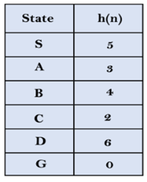
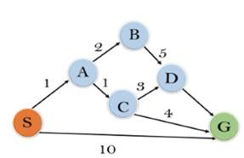
A* Search Algorithm (Example)
Traverse the given graph using the A* algorithm.
The heuristic value of all states is given in the below table so calculate the f(n) of each state using the formula
where g(n) is the cost to reach any node from start state.
OPEN and CLOSED list are used.

Slide 13
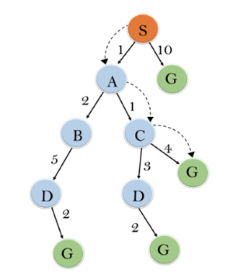
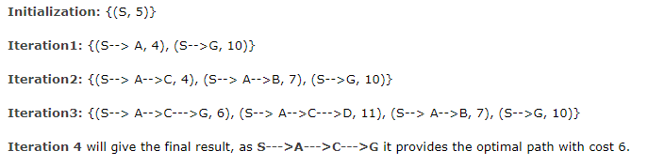
A* Search Algorithm (Example)

Slide 14
A* Search Algorithm
Complete:
A* algorithm is complete as long as:
Branching factor is finite.
Cost at every action is fixed.
Optimal:
A* search algorithm is optimal.
Time Complexity:
The time complexity of A* search algorithm depends on heuristic function, and the number of nodes expanded is exponential to the depth of solution d. So the time complexity is O(b ^ d)
where b is the branching factor.
Space Complexity:
The space complexity of A* search algorithm is O(b ^ d)

